Slide 1
Blood Relation
(L – 1)

Slide 2
Blood Relation
Introduction to Topic
Concept of family tree and sign conventions
Basic Problems on family tree
The problems with pointing to a picture
Symboperation related problems
Puzzle related problems
Data Sufficiency Based Problems

Slide 3
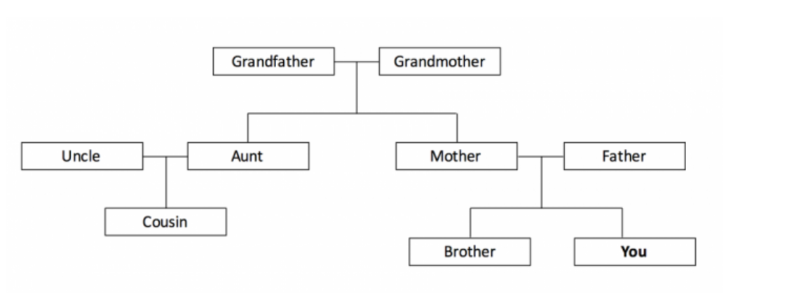
Blood Relation
Blood relation reasoning involves in reaching the conclusion by applying the rules of relationships within a family structure, often through direct or coded questions, and mastering it requires understanding familial connections and practicing logical deductions.

Slide 4
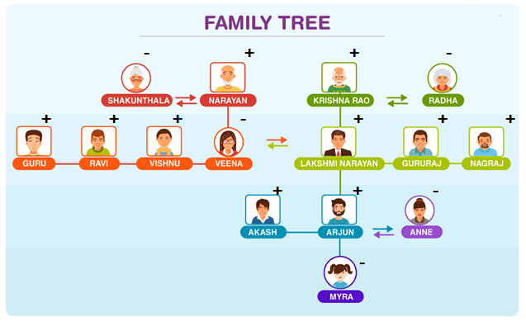
FAMILY TREE
Blood Relation
1. All the female members of the family are represented by a negative sign.
2. All the male members of the family are represented by a positive sign.
3. The relation between two members of the family is shown by connecting a double-headed arrow.
4. The spouse relation is represented by the two ends of a double-headed arrow.
5. All the family members of the upper generation are represented above in the family tree. Ex: father, mother, uncle, aunt etc. The logic can be extended by representing the grandparents above the parents in the family tree. Ex: grandfather and grandmother.
6. All the family members of the same generation are represented in the middle of the family tree. Ex: brothers, Sisters, cousins, wife, husband, etc.
7. All the family members of the next generation are represented below in the family tree. Ex: Daughter, son, niece, nephew.
8. Here’s a schematic representation of a family tree:

Slide 5
Blood Relation
Relations of Paternal Side
1. Father's father → Paternal Grandfather
2. Father's mother → Paternal Grandmother
3. Father's brother → Paternal Uncle
4. Wife of uncle → Aunt
5. Father's sister → Aunt
6. Husband of aunt → Uncle
7. Child of uncle/aunt → Cousin
Relations of Maternal Side
1. Mother's father → Maternal grandfather
2. Mother's mother → Maternal grandmother
3. Mother's brother → Maternal uncle
4. Wife of uncle → Aunt
5. Mother's sister → Aunt
6. Husband of aunt → Uncle
7. Child of maternal uncle/aunt → Cousin

Slide 6
Blood Relation
In-Laws Relations
1. Sister's husband is called brother-in-law
2. sister's/Cousin's husband is called Brother-in-law
3. Brother's/Cousins wife is called Sister-in-law
4. Wife's sister is called Sister-in-law
5. Son's/Nephew's wife is called daughter-in-law
6. Daughter's/Niece's husband is called son-in-law

Slide 7
Blood Relation
A and B are brothers. E is the daughter of F. F is the wife of B. What is the relation of E to A?
A) Niece
B) Daughter
C) Sister
D) Sister-in-law
Notes:
Option A

Slide 8
Blood Relation
2. A is the brother of B, C is the father of D, E is the mother of B. A and D are brother. How is E related to C?
A) Niece
B) Mother
C) Wife
D) Sister
Notes:
Option C

Slide 9
Blood Relation
3. A is the brother of B. B is the brother of C. D is the father of A. Based on these three statements, which of the following statements cannot be definitely true?
A) A is the brother of C
B) C is the brother of A
C) B is the brother of A
D) B is the son of D
Notes:
Option B

Slide 10
Blood Relation
4. A is the uncle of B, who is the daughter of C and C is the daughter-in-law of P. How is A related to P?
A) Son
B) Son-in-law
C) Brother
D) Grandson
Notes:
Option A

Slide 11
Blood Relation
5. In a family, X and Y are sisters. Y is the mother of A. C is the son of A. B is the son of X. Which of the following statements is true?
A) A is the son of X and Y.
B) B and A are cousins.
C) X is the Father of B.
D) X is C’s Grandmother.
Notes:
Option B

Slide 12
Blood Relation
6. Akshay told Vivek, “Yesterday I defeated the only brother of the daughter of grandmother.” Whom did Akshay Defeat?
A) Son
B) Son-in-law
C) Brother
D) Father
Notes:
Option : D

Slide 13
Blood Relation
7. Introducing Asha to guests, Mr. Bhaskar said, “Her father is the only son of my father”. How is Asha related to Bhaskar?
A) Cousin
B) Daughter
C) Niece
D) Friend
Notes:
Option B

Slide 14
Blood Relation
8. Pointing out a man receiving the prize, Malaika said, “He is the brother of my uncle’s daughter.” Who is the man to Malaika?
A) Brother
B) Uncle
C) Cousin
D) Nephew
Notes:
Option C

Slide 15
Blood Relation
9. Pointing to a girl in the picture, Salman said, “Her mother’s brother is the only son of my mother’s father.” How is the girl’s mother related to Salman if the girl is not the real sister of Salman?
A) Aunt
B) Grandmother
C) Sister
D) None
Notes:
Option A

Slide 16
Blood Relation
10. Pointing to a boy on the stage, Aashi said, “He is the brother of the daughter of the wife of my husband.” How is the boy on the stage related to Aashi?
A) Husband
B) Cousin
C) Son-in-law
D) Son
Notes:
Option D

Slide 17
Blood Relation
Read the following information carefully and answer the question given below:
If ‘A × B’ means ‘A is father of B’.
If ‘A + B’ means ‘A is wife of B’.
If ‘A ÷ B’ means ‘A is daughter of B’.
If ‘A – B’ means ‘A is son of B’.
11. How is L related to Q in the expression ‘L ÷ M × O – P ÷ Q’?
A) Daughter
B) Daughter-in-law
C) Granddaughter
D) Niece
Notes:
Option : C

Slide 18
Blood Relation
Read the following information carefully and answer the question given below:
If ‘A × B’ means ‘A is father of B’.
If ‘A + B’ means ‘A is wife of B’.
If ‘A ÷ B’ means ‘A is daughter of B’.
If ‘A – B’ means ‘A is son of B’.
12. What will come in the place of the question mark, to establish that Q is the nephew of T in the expression: ‘Q ? R ÷ S × T’ ?
A) x
B) ÷
C) +
D) -
Notes:
Option : D

Slide 19
Blood Relation
Study the following information carefully and answer the question given below:
‘P + Q’ means ‘P is the sister of Q’.
‘P # Q’ means ‘P is the husband of Q’.
‘P $ Q’ means ‘P is the daughter of Q’.
‘P % Q’ means ‘P is the mother of Q’.
‘P @ Q’ means ‘P is the brother of Q’.
13. What should come in the place of the question mark (?), to establish that ‘B is the child of K’ in the following expression?
T % K # F % L + N ? B
A) Either ‘+’ or ‘@’
B) Only ‘%’
C) Either ‘@’ or ‘%’
D) Only ‘#’
Notes:
Option : A

Slide 20
Blood Relation
Study the following information carefully and answer the question given below:
‘P + Q’ means ‘P is the sister of Q’.
‘P # Q’ means ‘P is the husband of Q’.
‘P $ Q’ means ‘P is the daughter of Q’.
‘P % Q’ means ‘P is the mother of Q’.
‘P @ Q’ means ‘P is the brother of Q’.
14. Which of the following expressions denotes that ‘J is the wife of F’?
A) P $ J % R + K % F
B) J % P + K @ R $ F
C) J % P # K + R % F
D) R @ P + K $ F @ J
Notes:
Option B

Slide 21
Blood Relation
Kindly study the following information carefully and answer the question that follows:
J is sister of T. T is married to D. D is father of R.
M is son of H. T is mother-in-law of H.
D has only one son and no daughter.
J is married to B. L is daughter of B.
15. How is L related to T?
A) Niece
B) Sister
C) Sister-in-law
D) Can’t determine
Notes:
Option :A

Slide 22
Blood Relation
Kindly study the following information carefully and answer the question that follows:
J is sister of T. T is married to D. D is father of R.
M is son of H. T is mother-in-law of H.
D has only one son and no daughter.
J is married to B. L is daughter of B.
16. How is J related to R?
A) Aunt
B) Sister
C) Sister-in-law
D) Mother
Notes:
Option A

Slide 23
Blood Relation
A family of nine members – Bala, Shalu, Honey, Chand, Geet, Gopi, Jassi, Kinjal and Bittu distributed along 3 generations. Such that:
Bala is Bittu’s grandmother. Chand is Kinjal’s mother. Gopi is Shalu’s son in law. Honey is Geet’s husband. Jassi is Bittu’s sister. Chand has a brother, a niece and a nephew. Only couples have children.
17. How is Kinjal related to Bittu’s grandmother?
A) Uncle
B) Son
C) Son-in-law
D) Can’t determine
Notes:
Option : D

Slide 24
Blood Relation
A family of nine members – Bala, Shalu, Honey, Chand, Geet, Gopi, Jassi, Kinjal and Bittu distributed along 3 generations. Such that:
Bala is Bittu’s grandmother. Chand is Kinjal’s mother. Gopi is Shalu’s son in law. Honey is Geet’s husband. Jassi is Bittu’s sister. Chand has a brother, a niece and a nephew. Only couples have children.
18. How is Shalu’s son in law related to Geet’s husband?
A) Brother
B) Son
C) Brother-in-law
D) Father
Notes:
Option : C

Slide 25
Blood Relation
A family of nine members – Bala, Shalu, Honey, Chand, Geet, Gopi, Jassi, Kinjal and Bittu distributed along 3 generations. Such that:
Bala is Bittu’s grandmother. Chand is Kinjal’s mother. Gopi is Shalu’s son in law. Honey is Geet’s husband. Jassi is Bittu’s sister. Chand has a brother, a niece and a nephew. Only couples have children.
19. Four of the following five are alike in a certain way and hence form a group. Which of the following is the one that does not belong to the group?
A) Gopi
B) Chand
C) Honey
D) Geet
E) Bala
Notes:
Option : E

Slide 26
Blood Relation
20. O, M, P, Q, S and T are six members in a family. P is not mother of M but M is son of P. O and P are a married couple. S is the brother of P. T is brother of M. Q is daughter of O.
How T is related to S?
A) Uncle
B) Father
C) Nephew
D) Son
Notes:
Option : C

Slide 27
Blood Relation
21. O, M, P, Q, S and T are six members in a family. P is not mother of M but M is son of P. O and P are a married couple. S is the brother of P. T is brother of M. Q is daughter of O.
How many children do O and P have?
A) 1
B) 2
C) 3
D) 5
Notes:
Option : C

Slide 28
Blood Relation
22. Kavya is mother-in-law of Rekha who is Sister-in-law of Rajveer. Rajveer, who is the only brother of Ravi, is the son of Sukhmit. How in Kavya related to Rajveer?
Wife
Mother
Aunt
Mother-in-law
Notes:
Option : B

Slide 29
Blood Relation
23. Priyam is the son of Sister of Jena’s father. Vineet is Son of Khushi who is the mother of Sushil and grandmother of Jena. Preetjot is the father Kanishka and maternal grandfather of Priyam. Khushi is the wife of Preetjot. How is Sushil’s wife related to Kanishka?
(a) Niece
(b) Sister-in-law
(c) Sister
(d) Data inadequate
Notes:
Option : B

Slide 30
Blood Relation
Directions:- (Q.24-28): Read the information given below and answer the following question. A is the father of C, but C is not his son. E is the daughter of C. F is the wife of A. B is the brother of C. D is the son of B. G is the wife of B. H is the father of G.
Q 24. Who is the paternal grandmother of D?
(a) H (b) A
(c) C (d) F
Notes:
Option : D

Slide 31
Blood Relation
Directions:- (Q.24-28): Read the information given below and answer the following question. A is the father of C, but C is not his son. E is the daughter of C. F is the wife of A. B is the brother of C. D is the son of B. G is the wife of B. H is the father of G.
25. Who is the son of F?
(a) B (b) C
(c) E (d) D
(e) Cannot be determined
Notes:
Option : A

Slide 32
Blood Relation
Directions:- (Q.24-28): Read the information given below and answer the following question. A is the father of C, but C is not his son. E is the daughter of C. F is the wife of A. B is the brother of C. D is the son of B. G is the wife of B. H is the father of G.
26. Who is the father-in-law of B?
(a) C (b) A (c) E
(d) H (e) None of these
Notes:
Option : D

Slide 33
Blood Relation
Directions:- (Q.24-28): Read the information given below and answer the following question. A is the father of C, but C is not his son. E is the daughter of C. F is the wife of A. B is the brother of C. D is the son of B. G is the wife of B. H is the father of G.
27. Who is the sister-in-law of C?
(a) D (b) G (c) F
(d) E (e) Cannot be determined
Notes:
Option : B

Slide 34
Blood Relation
Directions:- (Q.24-28): Read the information given below and answer the following question. A is the father of C, but C is not his son. E is the daughter of C. F is the wife of A. B is the brother of C. D is the son of B. G is the wife of B. H is the father of G.
28. Who is the cousin of E?
(a) C (b) B (c) H
(d) D (e) None of these
Notes:
Option : D

Slide 35
Blood Relation
29. How is P related to R?
I Q is the son of R.
II Q is the brother of P.
A) if the data in statement I alone are sufficient to answer the question, while the data in statement II alone are not sufficient to answer the question.
B) if the data in statement II alone are sufficient to answer the question, while the data in statement I alone are not sufficient to answer the question.
C) if the data either in statement I alone or in statement II alone are sufficient to answer the question.
D) if the data in both the statements I and II together are not sufficient to answer the question.
E) if the data in both the statements I and II together are necessary to answer the question.
Notes:
Option : D

Slide 36
Blood Relation
30. How is Shubham related to Shivani?
I. Shubham is brother of Meenal. Shivani is niece of Pooja.
II. Neeraj is Meenal’s uncle and Preeti’s brother
A) if the data in statement I alone are sufficient to answer the question, while the data in statement II alone are not sufficient to answer the question.
B) if the data in statement II alone are sufficient to answer the question, while the data in statement I alone are not sufficient to answer the question.
C) if the data either in statement I alone or in statement II alone are sufficient to answer the question.
D) if the data in both the statements I and II together are not sufficient to answer the question.
E) if the data in both the statements I and II together are necessary to answer the question.
Notes:
Option : D

Slide 37
Any Doubts???

